Slide 1
FastTrack for Dynamics 365
Solution Blueprint Workshop
Created On: dd/MM/yyyy

Slide 2
Solution Blueprint Workshop Agenda
Agenda
Understand your Program Design, provide best practices review, highlight any risks and gaps in the plan. Product roadmap and release alignment.
Program Strategy
Test Strategy
Attendees: Key stakeholders from the customer and partner teams. Solution architects, functional and technical leads are mandatory.
Requirements: Solution Blueprint WS templates filled out. High level Solution Architecture completed. Project plan and team roles defined.
Business Process Strategy
Application Strategy
Data Strategy
Integration Strategy
Intelligence Strategy
Security Strategy
ALM Strategy
Environment & Capacity Strategy

Slide 3
Introductions

Slide 4
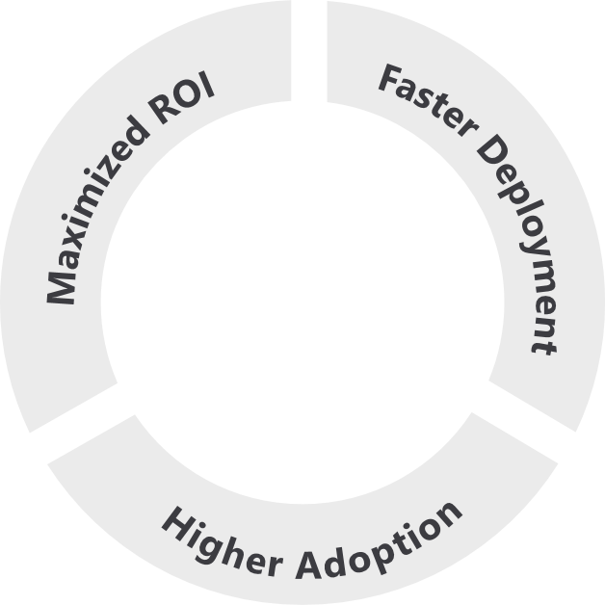
Based on Success by Design
The Dynamics 365 engineering team brings you the learnings and experiences from 3000+ cloud deployments through Success by Design.
Success by Design (SbD) is the prescriptive guidance - approaches & recommended practices - for designing, building and deploying a Dynamics 365 solution.
It is grounded in fundamentals of good solution architecture and design, product capabilities, and proven approaches to business process transformation and implementation.
Designed around three core principles:
2.2x
higher usage of Dynamics 365
Early Detection
Proactive Guidance
Predictable Success
Notes:
Source: The data point of 2.2x higher usage of Dynamics 365 is based on data analysis by the FastTrack team on the MAU of FastTrack tenants vs non-FastTrack tenants for above 500 seats.

Slide 5
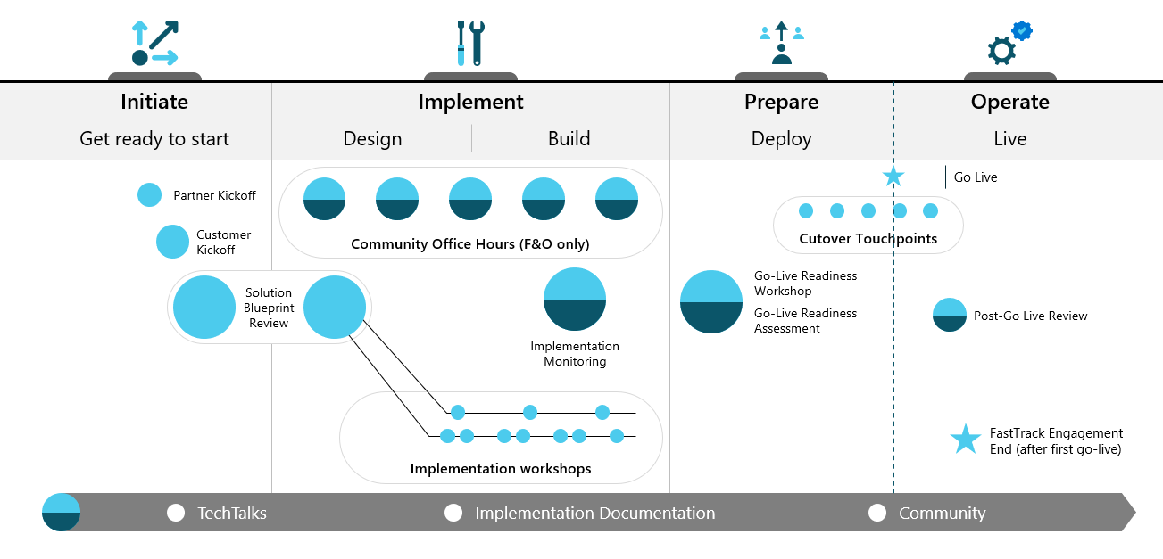
Initiate-Solution Blueprint Workshop
Refine your vision, identify and prioritize business scenarios, and collaborate with key stakeholders to plan for successful rollouts at your own pace.
High Level Architecture and Solution
Project Plan and Governance Model
Application Lifecycle Management and Release Plan

Slide 6
The Role of FastTrack
In Scope
Review the answers provided
Provide findings and recommendations following the workshop presentation
Provide alternatives to product gaps identified
Highlight technical and project risks and issues (including unrealistic product expectations)
Point out gaps in the solution or project structure that can result in an unsuccessful implementation
Out of Scope
Create a solution architecture based on findings
Decide on solutions that best fit gaps identified
Code review
Provide training on product features (user or administrative)
Create comparison between ISV solutions

Slide 7
Instructions for Customer and Partner
How to fill this PowerPoint document
Complete each slide providing the required information
Skip slides that are not applicable to your project
Extend topic area slides to capture the required information if needed. Do not hesitate to paste your own slides.
Reach out to your FastTrack SA if you have questions on the format or content
Send completed deck back to the FastTrack SA 5 business day before the scheduled Solution Blueprint workshop.
More information about what we look for in each section is provided in the
Solution Blueprint Review Workshop Guide

Slide 8
Program Strategy

Slide 9
Program Strategy
Brief overview of business
[Add an overview of your business]

Slide 10
Program Strategy
Business Challenges
[What are the current business challenges that this Program will help address?]

Slide 11
Program Strategy
Project goals and objectives
[Add goals and objectives]

Slide 12
Program Strategy - Solution Scope
Main Functional Areas
Sales
Customer Service
Field Service
Project Operations
Marketing
Finance
Commerce
HR
…
Phase & Timeline
Project start: <month> <year>
Current Project Phase: Design
Target go-live: <month> <year>
Number of users: ##
Business
Industry: Manufacturing
Business Model: B2B vs B2C
Geos: US and Canada
Default Language: EN-US
Default Currency: USD
Data center: US East
###
Total User Count
#
Geos
#
Project Phases
#
Integrations internal/external
#/#
Total Tenants/ Environments
#
ISV solutions

Slide 13
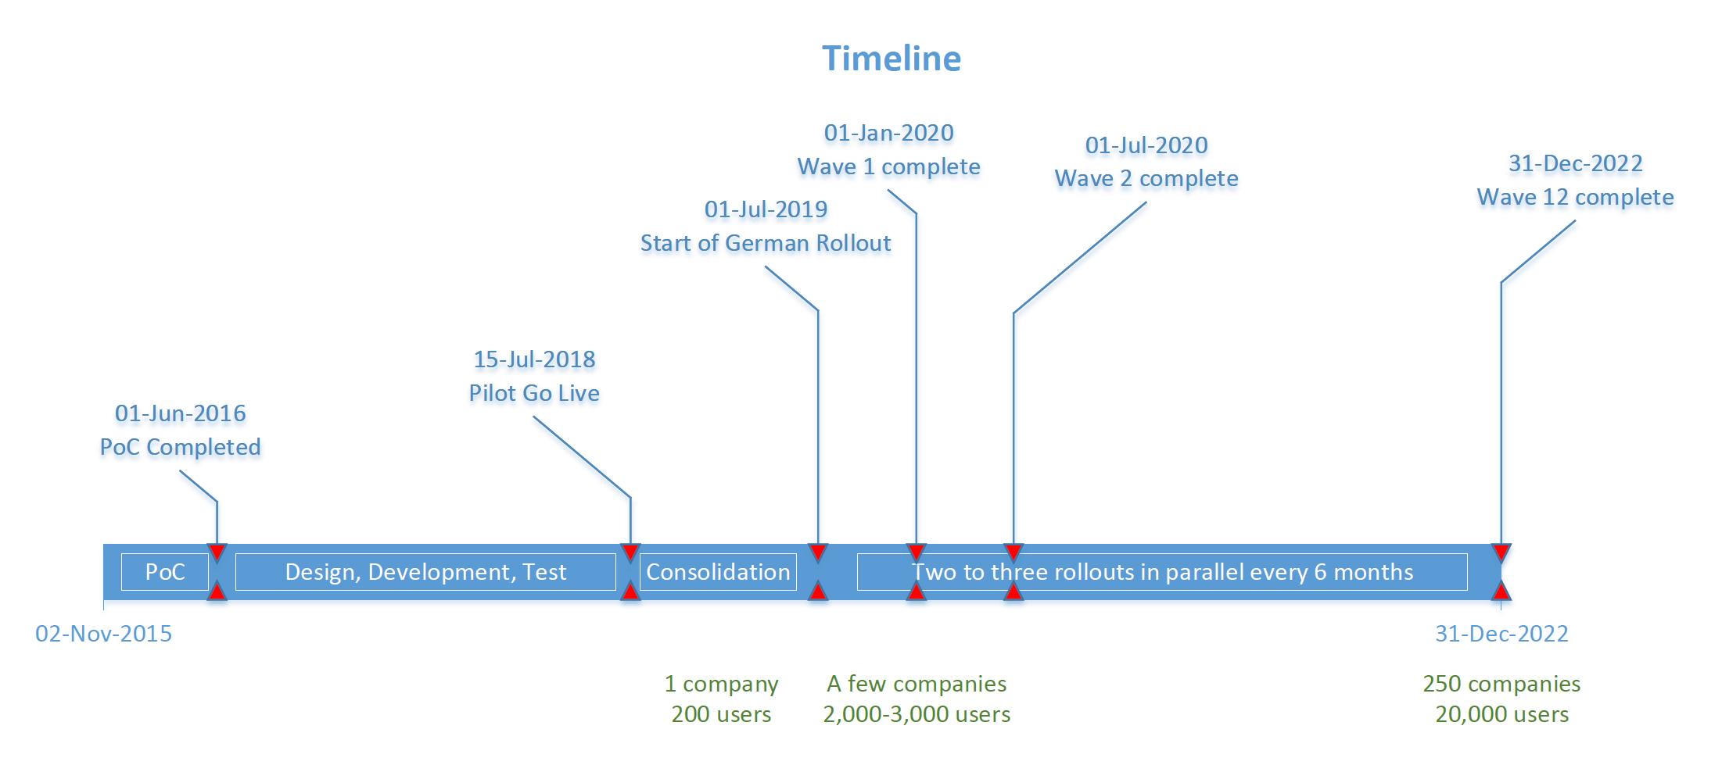
Program Strategy
Project Timeline

Slide 14
Program Strategy
Customer, Partner and Microsoft teams
Customer and Partner Program Team
Customer Business Sponsor: Eugenia Lopez
Customer Product Owner: Elizabeth Moore
Project Manager: Maria Sullivan
Solution Architect(s): Hannah Jarvis
Tenant Administrator(s): Grace Taylor
Data Migration Owner(s): Kiana Anderson
Training & Adoption: Madison Butler
Microsoft Team
Sales Team: Abigail Jackson
Account Executive: Natasha Jones
FastTrack SA: Monica Thomson
CSM: Briana Hernandez
CSAM (TAM): Hailey Clark

Slide 15
Test Strategy

Slide 16
Test Strategy
Test Plan, Non-Functional requirements in the testing strategy
Test Plan
Performance Test
Identification of Metrics & Input into Design
Performance and scalability goals

Slide 17
Business Process Strategy

Slide 18
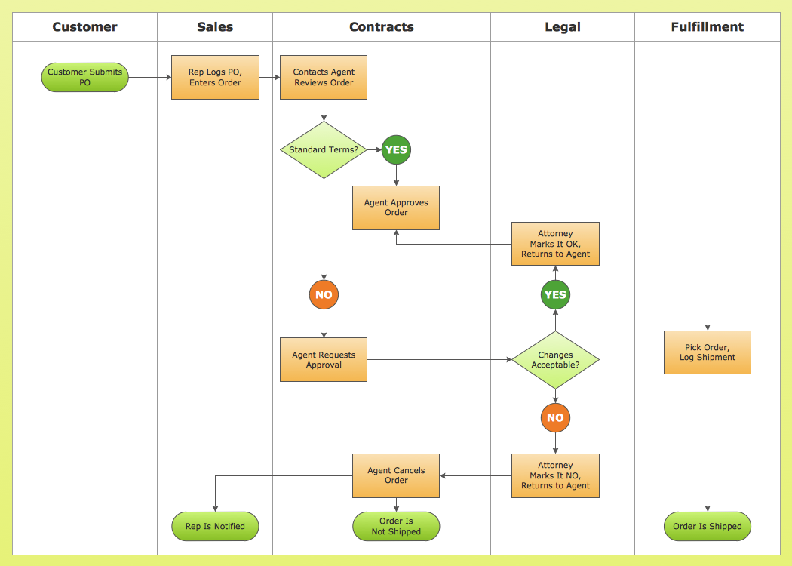
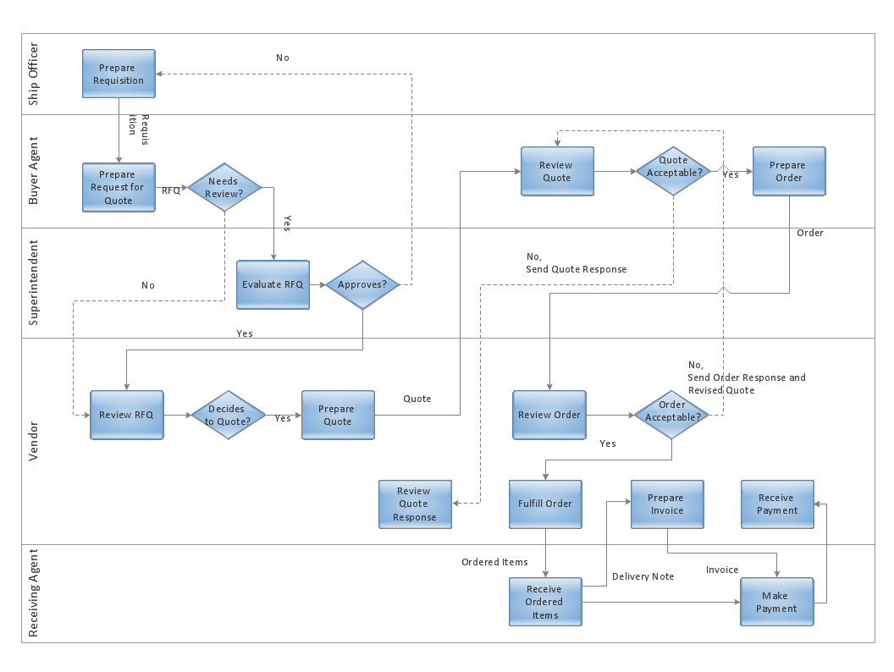
Business Process Strategy
Describe the 3-5 main business processes and personas
Dynamics 365 App: Finance / Supply Chain Management / Commerce / Sales / Customer Service / Project Operations / Field Service / Marketing / …
Process: <Process Name>, High level Description
Key Personas: Ex: Seller, Sales Mgr. , etc.
A blueprint that provides a conceptual view of the business process being implemented.
Example: The sales process, Field Service process, or custom regulatory process, etc.
💡 Check the Workshop Guide pptx for App related examples
Notes:
=========================
Why are we asking this information?
To be able to have a detailed view of the business processes being implemented:
Please include the following details:
For Sales:
Sales Process end-to-end (including sales channels integration)
For Customer Service:
Case lifecycle (including support channels integration, case escalations, SLA’s, stakeholders, KPI’s, etc.)
For Field Service:
Work Orders lifecycle (including channels integration, service and billing accounts, assets, agreements, service locations, currency and pricing, incident types and duration, characteristics, billing)
For Project Service Automation (See slides in the appendix for examples):
Sales Process end-to-end
Pricing strategy
Resource Assignment Process
Time Entry and Expenses Approval
Invoicing Process and volumes
For Marketing:
Customer jourvey end-to-end (including, Marketing Emails, Marketing pages and Forms, Segments, Leads, Events, Portals, Social Media)
=========================
What we’ll do with this information?
Better understand the architecture being built.
=========================
FAQ:

Slide 19
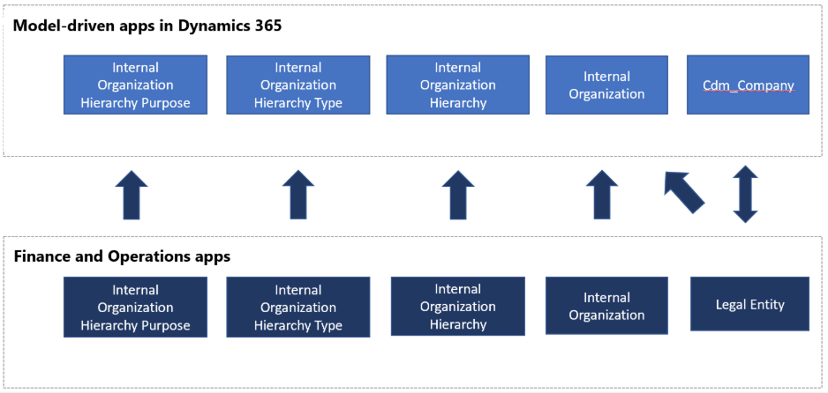
Business Process Strategy
Describe the Dataverse/F&O Integration flow
Dynamics 365 Apps: Sales / Customer Service / PSA / Field Service / Marketing
Process: <Process Name>
A blueprint that provides a conceptual view of the data integration data flows being implemented.
Example: The sales process, Field Service process, or custom regulatory process, etc.
💡 Check the Workshop Guide pptx for App related examples
Notes:
=========================
Why are we asking this information?
To be able to have a detailed view of the data flows being implemented:
Please include the following details:
Dynamics 365 Apps and Finance & Operations
Field Service to Finance & Operations
PSA to Finance & Operations
Data Integrator vs Dual Write
OOB Templates vs Custom Templates
Gaps
Additional relevant topics:
How many legal entities are part of this integration?
What are the standard vs custom integration flow?
How is number sequencing handled across systems?
What's the trigger / filter for data sync?
Are there any identified Gaps?
=========================
What we’ll do with this information?
Better understand the architecture being built.
=========================
FAQ:

Slide 20
Application Strategy

Slide 21
App Strategy - Dynamics 365 App Usage
Apps (* = live) | Insights | Reporting | Survey | CDS/F&O Integration | OOB/Custom MDA? | Flow vs Legacy WF | Embedded Canvas App
Sales | Sales Insights | PowerBI/Other | Customer Voice | DI/DW/Logic Apps | Sales Hub or custom | Both | Yes/No
Customer Service (CS) | CS Insights
Project Operations
Field Service
Marketing |  |  | Customer Voice
Customer Insights
Product Insights
Finance |  |  |  |  | N/A |  | N/A
Fraud Protection |  |  |  |  | N/A |  | N/A
Human Resources |  |  |  |  | N/A |  | N/A
Supply Chain Management |  |  |  |  | N/A |  | N/A
Commerce |  |  |  |  | N/A |  | N/A
* Delete what is not applicable
Notes:
=========================
Why are we asking this information?
To be able to have a better understanding of the app that are or will be used.
=========================
What we’ll do with this information?
Better understand the architecture being built.
Provide recommendations for new apps/features available
Align architecture with roadmap
=========================
FAQ:
Please identify if any of the Apps are already live, for example, if you’re implementing Sales App and Finance is already live, please add (Finance *) a star after Finance.
Remove any app, insights, etc. that are not part of your architecture.
Acronyms:
CDS – Common Data Service
F&O – Finance and Operations
MDA – Model Driven App
CDA – Canvas Driven App
WF – Workflow
CS – Customer Service
PSA – Project Service Automation
FS – Field Service
DI – Data Integrator
DW – Dual Write

Slide 22














App Strategy – Persona based Apps for Dataverse
Provide information on which of the examples below describes your app usage strategy.
vs
Unique App
Multiple Apps
App Driven
Unique or multiple per App
Sales
Customer Service
Field Service
Marketing
Project Service Automation
Role/Persona Driven
Salesperson
Sales Manager
Field Engineer
Support Engineer
System Admin
Security
Mobile

Slide 23
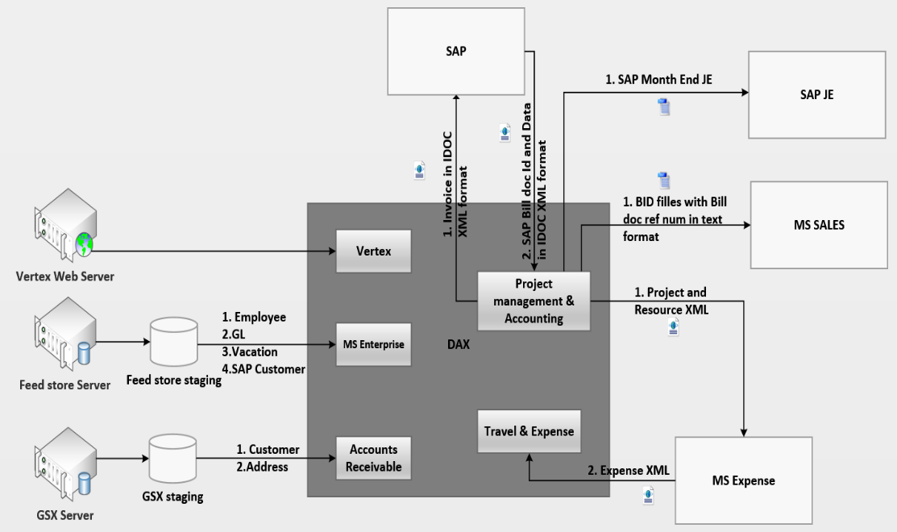
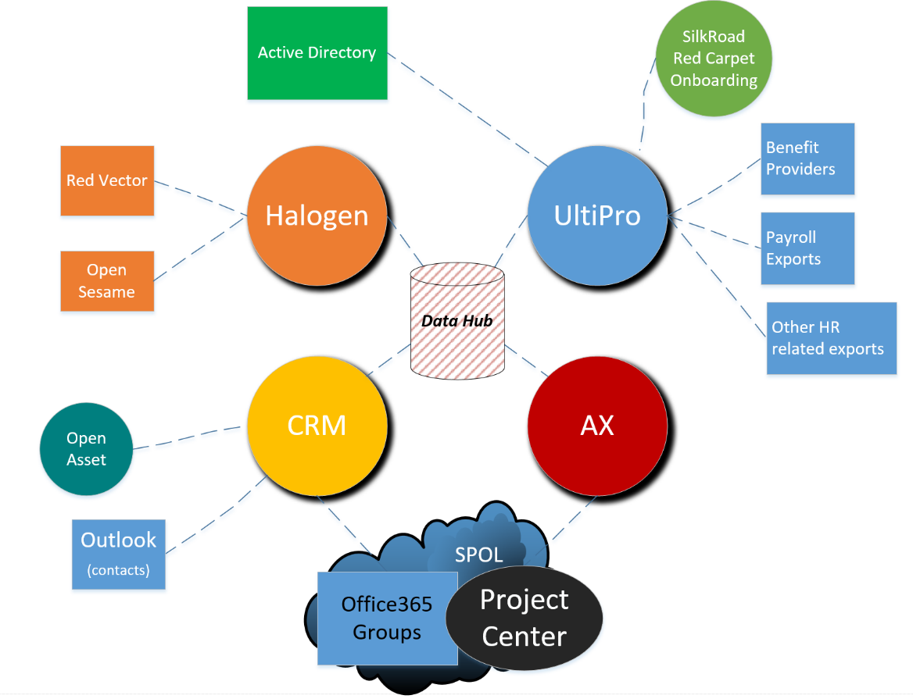
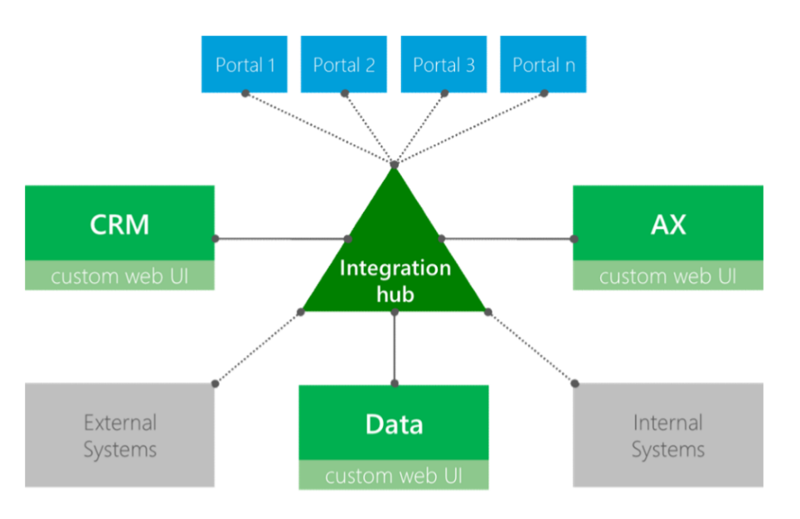
App Strategy - Solution Architecture
Blueprint, architecture diagrams, functional overview…
CE
F&O
F&O
CE
A blueprint that provides a conceptual view of the architecture being built
The view should cover system landscape and key interfaces, such as integrations with other systems

Slide 24
App Strategy - ISV Solutions/Add-ons
Describe all ISV solutions planned
ISV Name | Description | Risk | Company | Complexity | Available in AppSource
 |  |  |  |  | Y/N
Legend:
100 – Low Complexity
200 – Medium Complexity
300 – High Complexity
400 – Very High Complexity

Slide 25
App Strategy - Complex customizations (level 300 and above)
Detail all complex customizations involving custom developments
Purpose | Type (Plugin, JavaScript, PCF, Custom Actions, X++) | Justification | Execution time & Frequency | Complexity
💡 Legend
100 – Out-of-box Configuration
200 – No code Customization
300 – Some level of custom code
400 – Custom code involving integrations or intrusive customizations
Notes:
"In the SBR Stage we expect the Partner/Customer to highlight the areas that they will customize heavily, probably involving code based on the gaps identified. Understand the final design may not be there during SBR but surfacing these earlier in SBR will help create awareness and also let the SA focus on these areas through out the engagement.
It should be made very clear that any areas where partner plans to do level 300/400 customizations should be discussed with FT SA, so we can assess if something in roadmap will address this if not the customization being done is scalable and fits into the platform extension framework. Ex: PCF or a custom connector for Power Automate "

Slide 26
App Strategy - Gaps & Risks
Describe identified product gaps & project risks

Slide 27
App Strategy - Transaction Volumes
Outline your 24h operations schedule
See Solution Blueprint Template.xlsx
Notes:
Note that this is not to list out all entity changes but key deviations from standard CDM where you use a custom entity when OOB is present or when you repurpose or don’t use OOB attributes. Ex: Use a custom Opportunity/product entity. Use case title field to capture case number etc.
Deviations from CDM can have a severe impact on adoption on new capabilities in future

Slide 28
Data Strategy

Slide 29
Data Strategy - Data Model Customizations
Highlight areas where you will have to create new entities to replace standard entities and deviate from CDM, repurposed or recreated CDM attributes
See Solution Blueprint Template.xlsx
Notes:
Note that this is not to list out all entity changes but key deviations from standard CDM where you use a custom entity when OOB is present or when you repurpose or don’t use OOB attributes. Ex: Use a custom Opportunity/product entity. Use case title field to capture case number etc.
Deviations from CDM can have a severe impact on adoption on new capabilities in future

Slide 30
Data Strategy
Approach & Plan for Data Migrations
See Solution Blueprint Template.xlsx

Slide 31
Data Strategy
Master Data Management, Data sharing across legal entities, Configuration Management, Cutover plan
[Provide detailed information on this topics if applicable to your Program.]

Slide 32
Data Strategy
Data Retention and Data Archiving Strategy
[Provide detailed information on this topics if applicable to your Program.]

Slide 33
Integration Strategy

Slide 34
Integrations Strategy
Describe all data interfaces planned
See Solution Blueprint Template.xlsx

Slide 35
Intelligence Strategy

Slide 36
Intelligence Strategy
Reporting and Analytics Requirements
Types of Reporting (Operational, Financial and Insights)
Strategic organizational and executive reporting
Data warehousing Strategy
Embedded Intelligence Apps

Slide 37
Security Strategy

Slide 38
Security Strategy
Identity, Active Directory, security
Federation Setup / Conditional access / Single sign-on
Multi tenant & Cross Tenant Access
Integration Identity and Service Accounts
AD Access Management

Slide 39
Security Strategy
Roles, Field Level / XDS Policy
[Provide detailed information on this topics if applicable to your Program.]

Slide 40
ALM Strategy

Slide 41
ALM Strategy
Describe your strategy to deploy releases and hotfixes from development to production
ALM Environments
Release Process and Calendar
Build & Deployment Process
Source Control & Configuration Management
ISV ALM Strategy

Slide 42
Environment & Capacity Strategy

Slide 43
Environment Strategy
Tenants, Environments, Updates, Monitoring…
Tenant & Geo Strategy
Monitoring & Notification Management
Platform Release Process & Updates
ALM Alignment
Service Levels
Regulations & Compliance

Slide 44
Capacity Strategy
Aligning product, user licenses & add-ons to technical and business requirements
What license evaluation checkpoints do you have scheduled?
Impact of your architecture and design on licensing
Integration related licensing & cost, outside of Dynamics 365 is accounted for (ex. Multiplexing/order-line SKUs, Logic Apps, Azure Functions, ADL, SQL, etc.)
API Limits/throttling and capacity are taken into licensing consideration based on data volumes and load
Notes:
The intention of this slide is not to have a deep licensing conversation but to ensure that the
-> Bill of Material for the Project is kept up-to date and there is a process to work with MS licensing exec and SSP
-> Architecture takes into consideration the current licenses procured. Ex: No consideration for API add-ons , Lower Sales SKU with no insights etc
Customer should work with the licensing teams and the licensing partner to discuss this in the context of their EA. This is not intended for any commercial conversations but just a checkpoint to ensure solution is not bring built in complete isolation of what customer is entitled to.

Slide 45
Q & A Session

Slide 46

Disclaimer
© 2021 Microsoft Corporation. All rights reserved. Microsoft, Microsoft Dynamics, Office 365, Windows, and other product names are or may be registered trademarks and/or trademarks in the U.S. and/or other countries. The information herein is for informational purposes only and represents the current view of Microsoft Corporation as of the date of this presentation. Because Microsoft must respond to changing market conditions, it should not be interpreted to be a commitment on the part of Microsoft, and Microsoft cannot guarantee the accuracy of any information provided after the date of this presentation. MICROSOFT MAKES NO WARRANTIES, EXPRESS, IMPLIED OR STATUTORY, AS TO THE INFORMATION IN THIS PRESENTATION

Slide 47
Power Apps Portals Blueprint
Please introduce a description of the main functionality you are going to implement within the portal scope.
Are you currently using another Portal or CMS platform? What users are going to access the Portal? Anonymous access? Internal/External Users? Do you need to match/migrate users?
Portal User or Page Load Capacity Planned/Licensed?
Portal Template | Y/N | Portal Template | Y/N | Portal Template | Y/N
Customer Self-Service | Y | Employee Self-Service |  | Portal Custom Blank / Starter Portal
Partner Portal |  | Community Portal |  | Customer Portal
Feature | Y/N | Feature | Y/N | Feature | Y/N
Multi-Language Support | Y | Field Service Integration |  | Web Forms / Multi Step Forms
Knowledge Management |  | SharePoint Integration |  | Entity Lists / Entity Forms
Support/Case Management |  | Power BI Integration |  | Theming / Styling
Forums |  | Azure Storage integration |  | Ideas / Polls
Faceted/Global Search |  | Traffic Analyzer / App Insights |  | Blogs
Profile Management |  | External Identity Providers |  | Integration to other APIs/Data
Notes:
=========================
Why are we asking this information?
This information will give us an idea of the scope of your field service implementation plans.
=========================
What we’ll do with this information?
During the Solution Blueprint Review workshop, we will use this information to discuss in-scope functional areas of the of your intended field service solution. Helping to ensure that you have awareness of the variety capabilities the application offers, and have included them in your short, and long, term plans where relevant.
=========================
FAQ:
Key things
Right template is chosen
Potentially low used features which have little investment , Any recommendation - RKB will support the recommendation based on answers
Scenario

